Slide 1
Sales Dataset Analysis - Advanced Excel Project
Name : Mohamed Anwar sha
Date : 17/03/2025
Course : Data Science and Data Analysis
Batch : Feb 2025

Slide 2
Project Overview & Objectives
Project Objective:
Goals:
Provide actionable insights to enhance sales performance, identify areas of improvement, and capitalize on opportunities for growth.
Identify the best-selling products, analyze their sales trends, and determine the key factors driving their success.
Explore the connections between top-selling products, sales channels, discounts, and other influencing factors to gain valuable insights into sales dynamics.
Recognize the least-selling products, assess the reasons for their low performance, and develop strategies to enhance their sales.

Slide 3
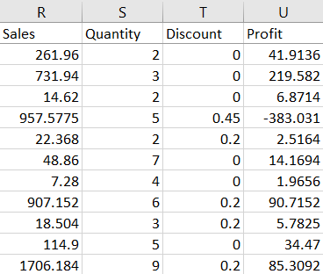
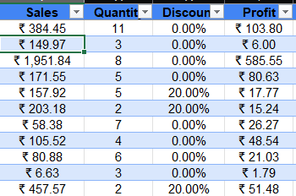
Data Description and Preparation
Dataset Overview:
In this Sales Data we have 9994 Rows with 21 columns.
Data Cleaning Process:
Used Power Query to convert column data types to the correct format,
Removed duplicate rows using Excel's "Remove Duplicates" feature,
Identified and addressed blank cells in the data.
Visuals:

Slide 4
Key Metrics Calculation and Data Analysis
Key Metrics:
Formulas:
Total sales =Sum(Sales)
Adjusted Sales =Sales – (Sales * Discount)
Average sales per order =Average(Sales)
Average Adj. sales per order =Average(Adjusted sales)
Discount % =Discount value / Total sales *100
Discount Values =Total sales – Adjusted sales
KPI | Values
Total Sales | ₹ 22,96,919.49
Adjusted sales | ₹ 19,74,421.77
Average sales per order | ₹ 229.85
Average Adjusted sales per order | ₹ 197.58
Discount% | 1404%
Discount Value | ₹ 3,22,497.72

Slide 5
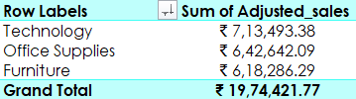
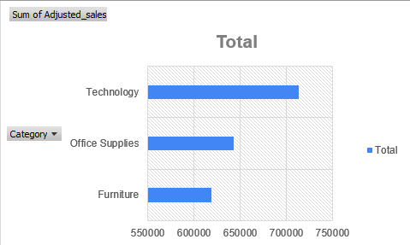
Pivot Tables and Pivot Charts
Pivot Table Summary:
I selected the entire data range, went to the "Insert" tab, and clicked on "PivotTable." I chose a cell to place the PivotTable and clicked "OK.“
Pivot Chart Visualizations:

Slide 6
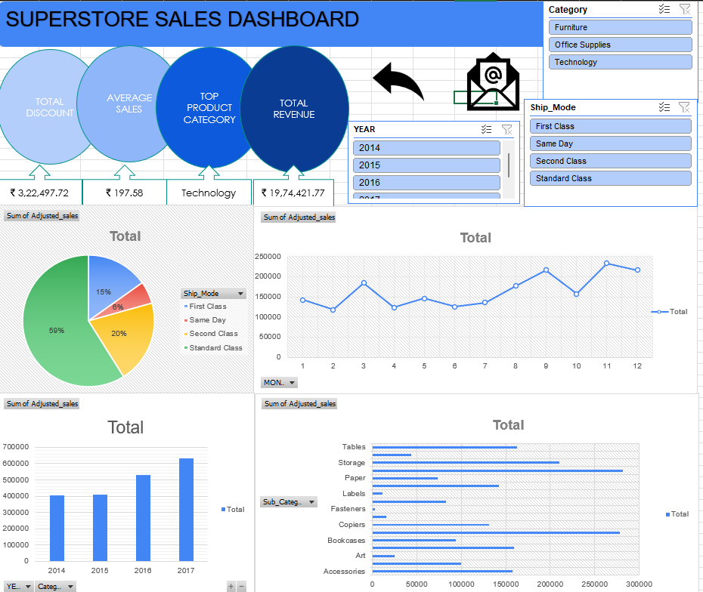
Dashboard Overview
Dashboard Design:
A dashboard is a visual representation of data that provides an at-a-glance view of key performance indicators (KPIs), trends, and insights. Its purpose is to make complex data more accessible, interactive, and actionable.
Visuals:

Slide 7
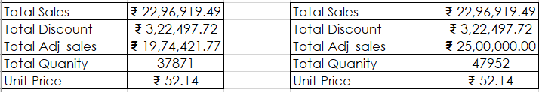
What-If Analysis & Goal Seek
What-If Analysis is the process of changing the values in cells to see how those changes will affect the outcome of formulas on the worksheet.
Goal Seek:
Create this go to Data > What-If-Analysis > Scenario Manager.
Below performs with some various sales increased and decreased discount and vice versa.

Slide 8
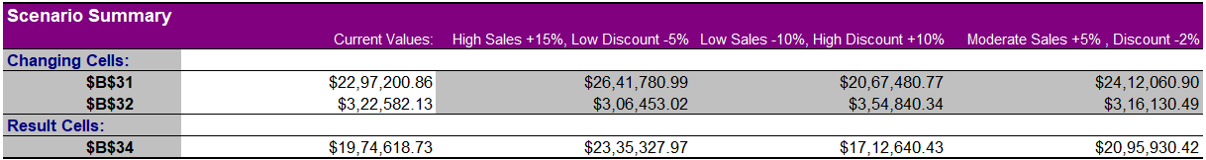
What-If Analysis – Scenario Manager
Create this go to Data > What-If-Analysis > Scenario Manager.
Below performs with some various sales increased and decreased discount and vice versa.

Slide 9
Insights and Recommendations
Key Insights:
The Technology category emerged as the top-performing sales segment, contributing 36% of total sales.
Interestingly, the high sales volume in this category aligned with a significant discount offering, suggesting that the discount strategy effectively drove sales.
Seasonal sales fluctuations were observed, particularly at the end of the year, with a noticeable surge during the holiday season (December to January). This indicates that customers actively take advantage of discounts and promotions during this period.
Analysis reveals that the Fasteners category has the lowest sales among all sub-categories, despite offering a relatively high discount rate of 17.80%.
To improve sales performance in this category, we recommend increasing the discount rate on Fasteners-related products.
If sales do not improve, plans are in place to discontinue Fasteners-related products.
This strategy can be monitored and adjusted as needed to achieve optimal results.

Slide 10
Conclusion
Summary:
From this Sales data Technology category offers the greatest opportunity for sales growth.
Discounts are an effective way to drive sales, particularly in the Technology category.
Seasonal sales planning is crucial to capitalize on peak sales periods.
Next Steps:
Increase investment in Technology category and allocate more resources to the Technology category to drive sales growth.
Develop seasonal sales plans: Create targeted sales plans to capitalize on peak sales periods, such as the holiday season.
By implementing these recommendations, the business can drive sales growth, increase revenue, and maintain a competitive edge in the market.

Slide 11
Questions
If you have any questions and comments!
Please feel free to ask questions and share your insights!

Slide 12
THANK YOU

